Slide 1
DR.SNSRCAS, CBE
SUBJECT: ADVANCED JAVA PROGRAMMING
COURSE CODE:16UCA502
TITLE: Architecture of JDBC
YEAR: V SEMESTER 2022-2023 (ODD)

Slide 2
Architecture of JDBC
The JDBC API supports both two-tier and three-tier processing models for database access.

Slide 3
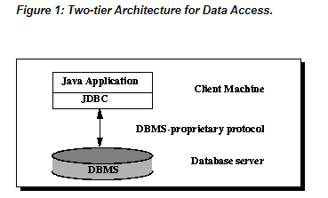
Architecture of JDBC

Slide 4
Architecture of JDBC
In the two-tier model, a Java applet or application talks directly to the data source. This requires a JDBC driver that can communicate with the particular data source being accessed. A user's commands are delivered to the database or other data source, and the results of those statements are sent back to the user

Slide 5
Architecture of JDBC
The data source may be located on another machine to which the user is connected via a network. This is referred to as a client/server configuration, with the user's machine as the client, and the machine housing the data source as the server. The network can be an intranet, which, for example, connects employees within a corporation, or it can be the Internet.

Slide 6
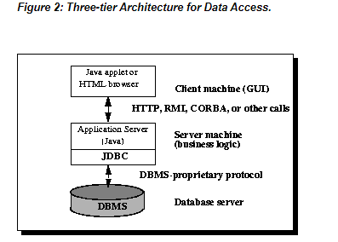
Architecture of JDBC

Slide 7
Architecture of JDBC
In the three-tier model, commands are sent to a "middle tier" of services, which then sends the commands to the data source. The data source processes the commands and sends the results back to the middle tier, which then sends them to the user. MIS directors find the three-tier model very attractive because the middle tier makes it possible to maintain control over access and the kinds of updates that can be made to corporate data.

Slide 8
Architecture of JDBC
Until recently, the middle tier has often been written in languages such as C or C++, which offer fast performance. However, with the introduction of optimizing compilers that translate Java byte code into efficient machine-specific code and technologies such as Enterprise JavaBeans™, the Java platform is fast becoming the standard platform for middle-tier development. This is a big plus, making it possible to take advantage of Java's robustness, multithreading, and security features.

Slide 9
Architecture of JDBC
With enterprises increasingly using the Java programming language for writing server code, the JDBC API is being used more and more in the middle tier of a three-tier architecture. Some of the features that make JDBC a server technology are its support for connection pooling, distributed transactions, and disconnected rowsets. The JDBC API is also what allows access to a data source from a Java middle tier.

Slide 10
THANK YOU

